Slide 1
AGILE MODEL
By Moolyans,
1.Mohammed Arbaaz,
2.Manoj Sappan,
3. Riya Garg,
4. Sandiyaa,
5.Dikshant Dixit.

Slide 2
Introduction to Agile Methodology

Slide 3
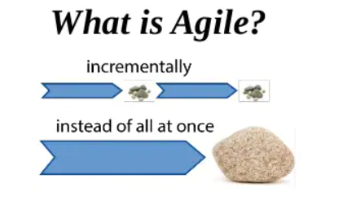
What is Agile?
Agile is the time boxed , iterative approach to software delivery that builds software incrementally from the start of the project, instead of trying to deliver all at once near the end.
It works by breaking projects down into the little bit of user functionality called user stories, prioritizing them, and then continuously delivering them in short two weeks cycle called iterations.

Slide 4
How does it work
YOU MAKE A LIST :
Sitting down with your customer you make a list of features they would like to see in their software. We call these things user stories and they become the To Do list for your project.
YOU SIZE THINGS UP :
You size(estimate) your stories relatively to each other , coming up with a guess as to how long you think each user story will take.
YOU SET SOME PRIORITIES :
Like most list , there always seems to be more to do than time allows. So you ask your customer to prioritize their list so you get the most important stuffs done first, and save the least important for last.

Slide 5
Cont...
YOU START EXECUTING
Then you start delivering some value. You start at the top . work your way to the bottom, iterating, and getting feedback from your customer as you go.
YOU UPDATE THE PLAN AS YOU GO
Then you and your customer start delivering one of the two things is going to happen. You’ll discover:
You're going fast enough . All is good. Or,
You have too much to do and not enough time.

Slide 6
Process Flow of Agile Methodology
Concept : Project is imagined and prioritized
Inception : Team members are created , funding is put in place .
Iteration : The SD team works to deliver the working software.
Release : Perform QA testing and giving out the final version of the iteration.
Production : Production of the s/w or the product.

Slide 7
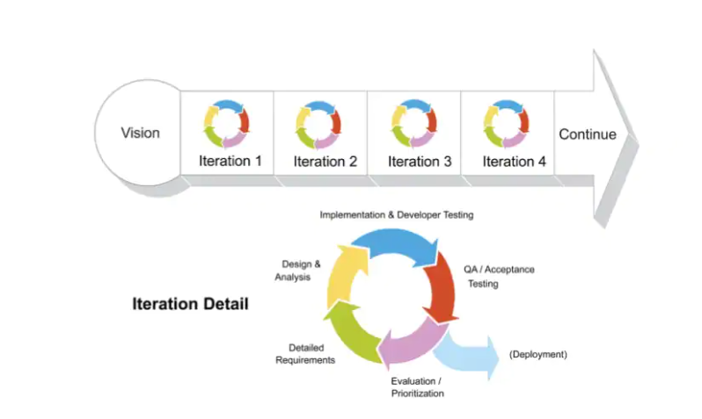
Iteration of the Process

Slide 8
Merits of Agile method
1.Customer satisfaction by rapid, Continuous delivery of useful software.
2.Enhance the features then and there in next versions.
3.Faster compared to other models can execute within ⅔ weeks.
4.Even late changes in requirements are welcomed.
5.Customer,Developer,Product owner interacts regularly.
6.Regular Adaptation to the circumstances takes place.
7.Given attention in technical excellence and in good design.

Slide 9
DEMERITS OF AGILE MODEL

Slide 10
Frequent deliverables, feedback, and collaboration can be very demanding for some customers.
Because of the ever-evolving features, there is always a risk of the everlasting project.
For complex projects, the resource requirement and effort are difficult to estimate.
Lack of formal documentation and designing leads to a very high dependency on individuals for training and other tasks.
As it is highly customer-centric, so it can pose a problem when the customer does not have a clear understanding of the product and process.

Slide 11
Project Can be applied-
Agile is most appropriate on any urgent project with significant complexity and novelty--and that includes software development

Slide 12
Examples of Agile Methodology. The most popular and common examples are Scrum, eXtreme Programming (XP), Feature Driven Development (FDD), Dynamic Systems Development Method (DSDM), Adaptive Software Development (ASD), Crystal, and Lean Software Development (LSD)

